Slide 1

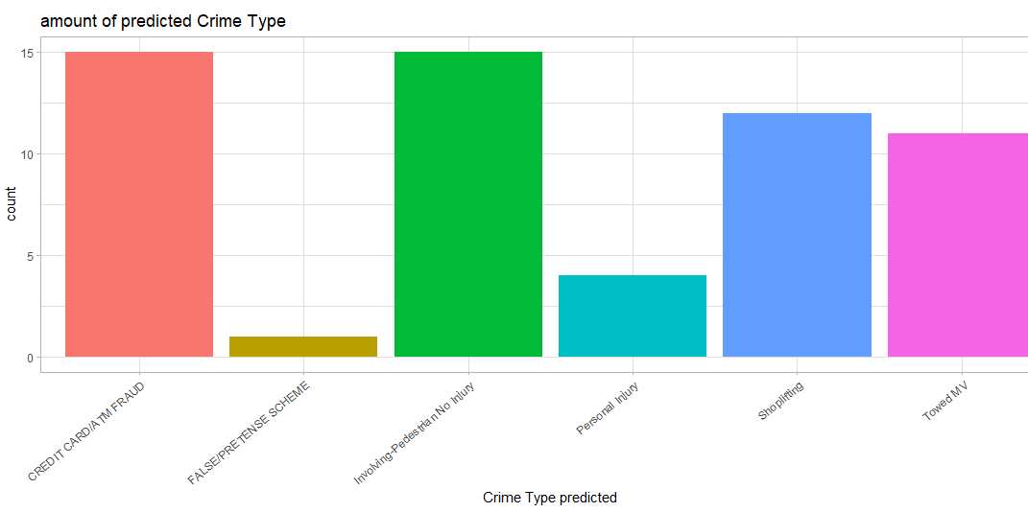
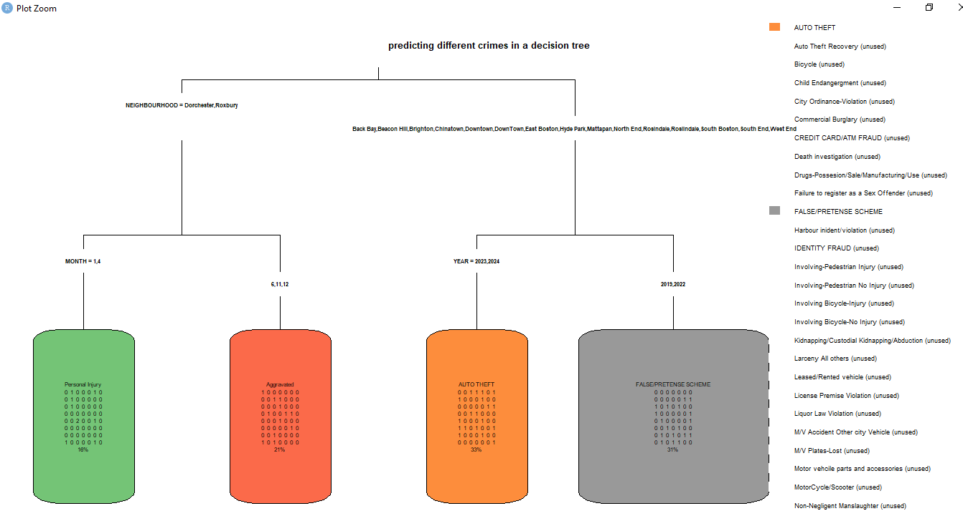
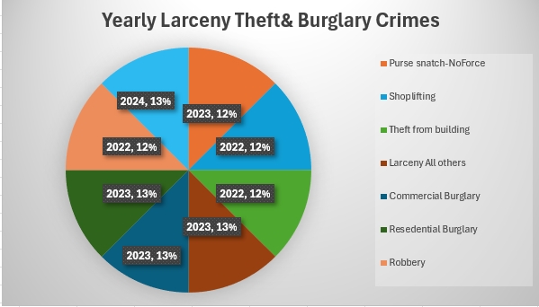
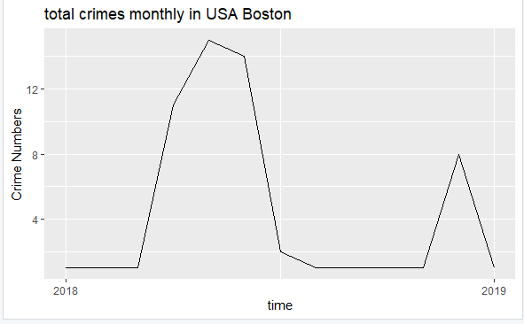
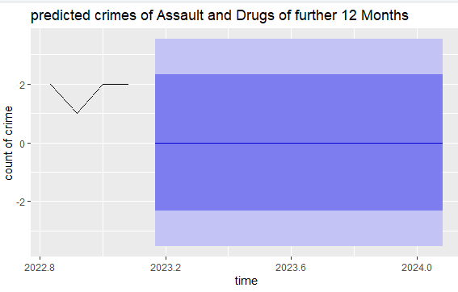
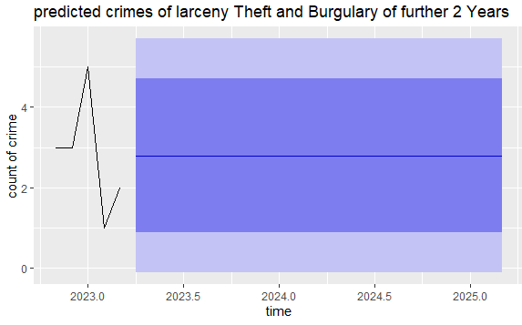
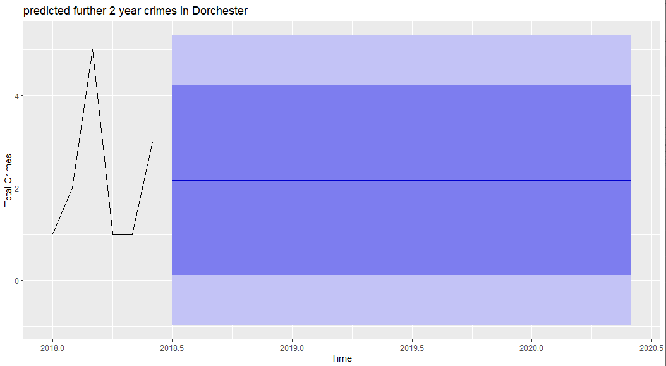
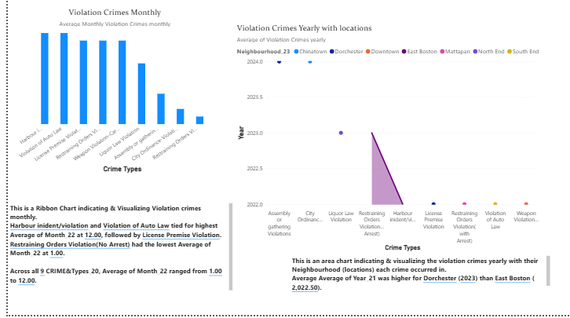
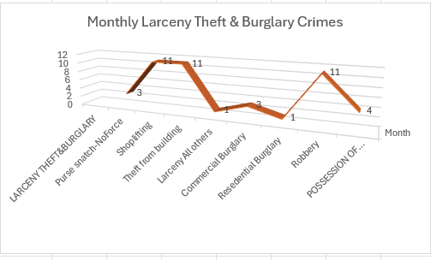
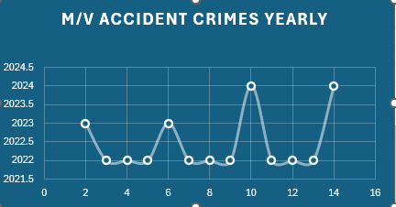
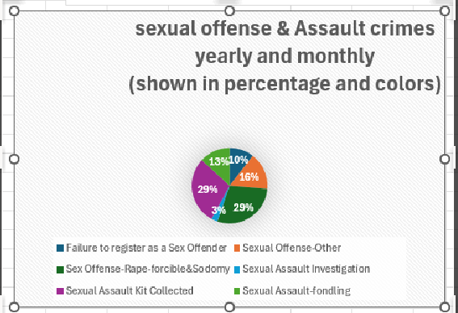
CRIME DATA ANALYSIS ON BOSTON,USA
HAFSA TABBSUM, BSHTM
Overview
This project uses analytical tools such as power BI, Excel and Programming tool of RStudio, to identify deeper insights, trends, patterns behaviors towards protection for the public and suggestion for policies regarding crime analysis.
Motivation
Supports in predicting crimes or incidents that could occur in the future., detects trends of crimes and
It helps governments or lawmakers manage resources, expenditures and improves protection for citizens.
It helps governments or lawmakers manage resources, expenditures and improves protection for citizens. I chose Boston area as it it is suitable for analyzing data and visualizations as it offers an easily accessible and comprehensively datasets of crime that is documented.
The target audience are specifically useful for law enforcement agencies, other criminal justice agencies, the public, private sectors and government.
Analysis & Results(decision trees, ARIMA etc)
I developed predictive models & visuals for crime analysis.
some predictive created in R, excel
powerBI

